Slide 1

Gym Web App

Slide 2

Objective: develop a Web Application used to manage a gym
Advantages of such a system for the business:
Digitalize and centralize information
Automatization of tasks that could lead to various errors and problems if “handmade”
Better way of keeping track of presences rather than doing it on… Excel Sheets

Slide 3
Core Functionalities and Privileges
Trainee
Subscribe to a course
Book a lesson
Manage personal area
1
Trainer
Manage lessons
Manage attendances
2
Secretary
Create high privileged accounts
Manage medical certificates
Manage subscriptions
Create courses
3

Slide 4
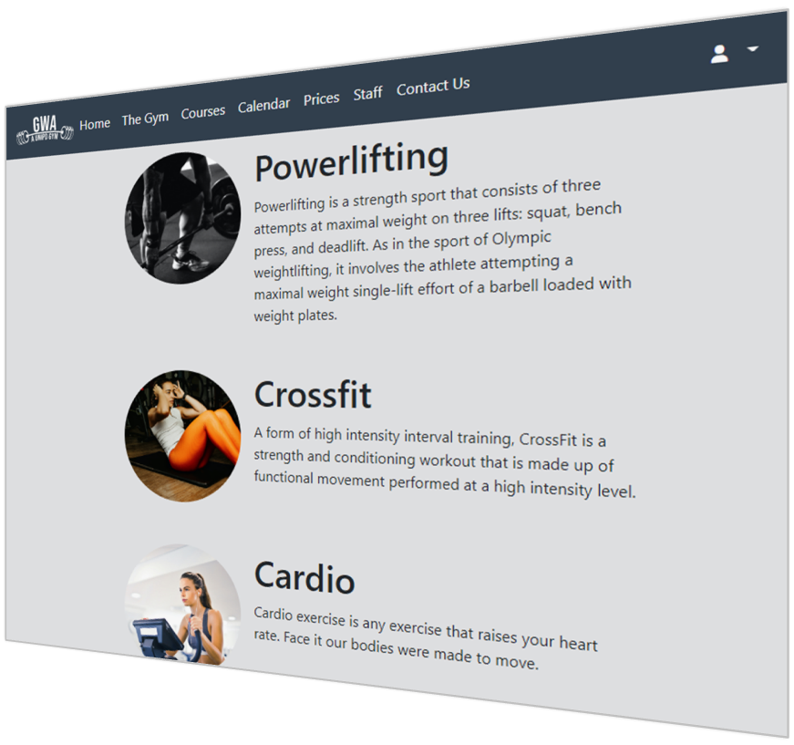
Filters
Public pages:
Home
The Gym
Courses
Calendar
Prices
Staff
Contact Us
Login …
Don’t need any filtering

Slide 5
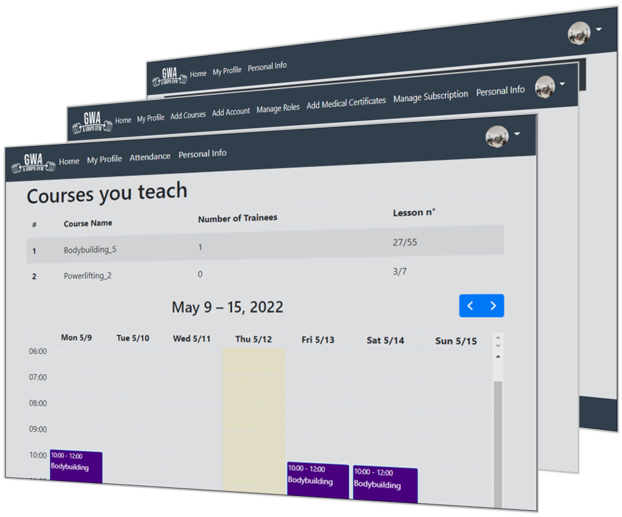
Filters
To access:
Secretary Area
Trainer Area
Trainee Area
We need to know if the user is
AUTHENTICATED
AUTHORIZED

Slide 6
Filters
FILTER CHAINING
SecretaryFilter
TrainerFilter
TraineeFilter
SecretaryArea
TrainerArea
TraineeArea
RestrictedAreaFilter

Slide 7


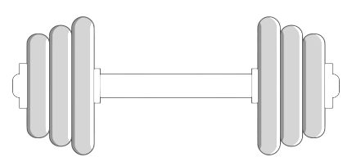


Trainee functionalities
Trainee
Enjoy his training
Buy a subscription in secretariat
Reserve a lecture time slot
Delete a lecture time slot

Slide 8
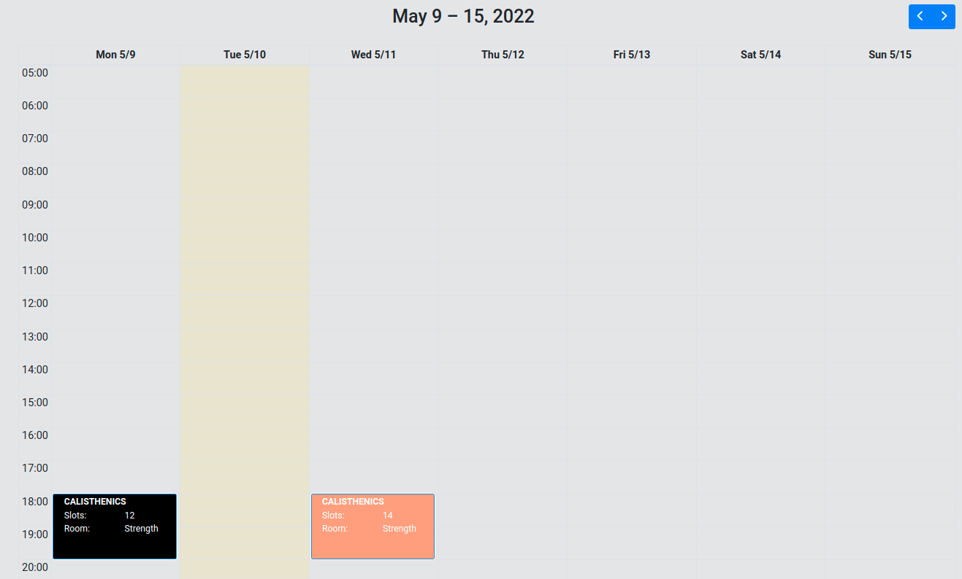
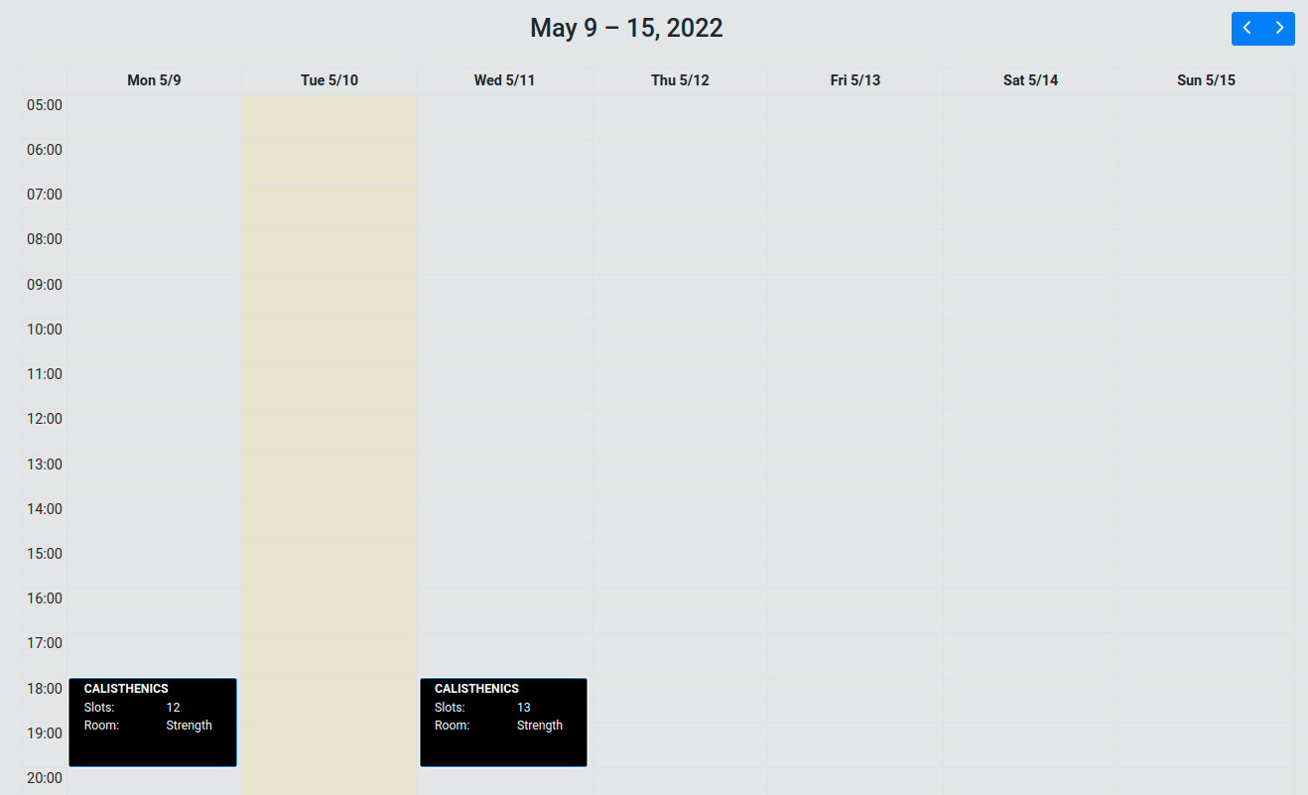
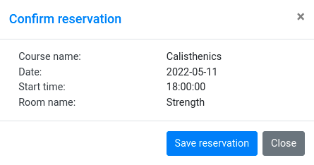
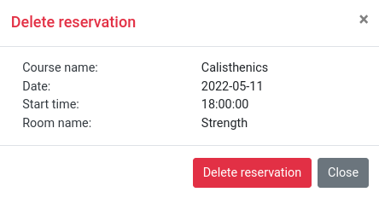
Trainee home page
Reserve a lecture time slot
Delete a lecture time slot

Slide 9
Trainee back-end
Rest API | METHOD | DAO
/trainee/rest/available/from-date/{date}/to-date/{date} | GET | GetLectureTimeSlotsAvailableForUserByWeekDatabase
/trainee/rest/reservation/from-date/{date}/to-date/{date} | GET | GetListReservationByEmailAndDateDatabase
/trainee/rest/reservation | POST | InsertReservationDatabase
/trainee/rest/reservation/room/{room}/date/{date}/starttime/{time} | DELETE | DeleteReservationDatabase

Slide 10



Trainer: tasks
Trainer
A trainer has to:
Teach his/her courses
Remove attendances from users who booked their attendance for a lecture but they are not present
Add attendances for users that did not book their attendance for a lecture if there are enough slots available in the given room
Organize his/her lectures with the secretaries (e.g. if sick, communicate to postpone/delete a lecture)
Manage attendances
Organize with secretaries
Teach courses

Slide 11
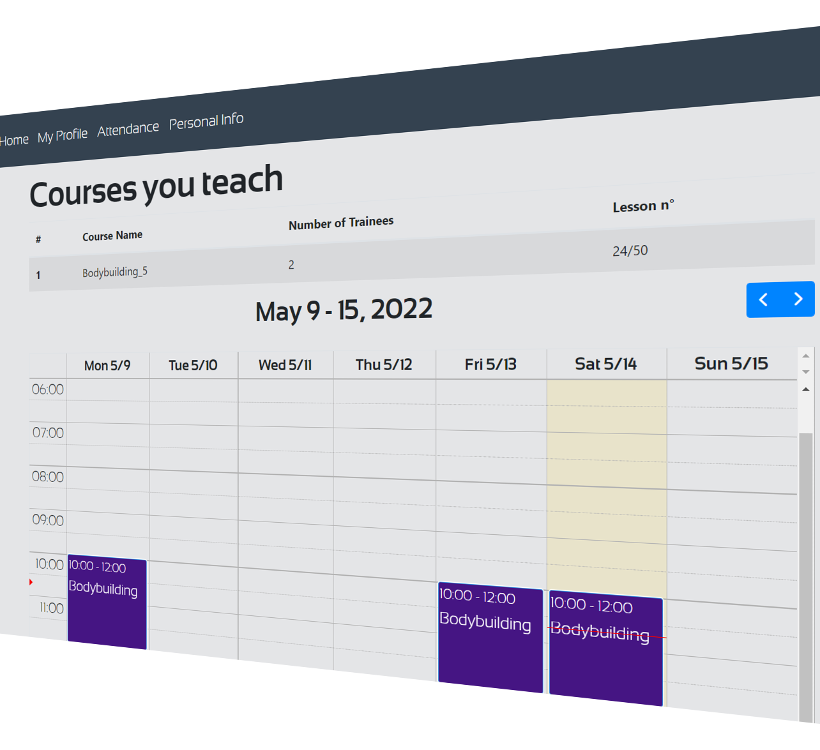
Trainer: home
Once logged-in, a trainer can:
Access his/her personal info
View the status of the courses he/she teaches
Access to the attendances-management section

Slide 12
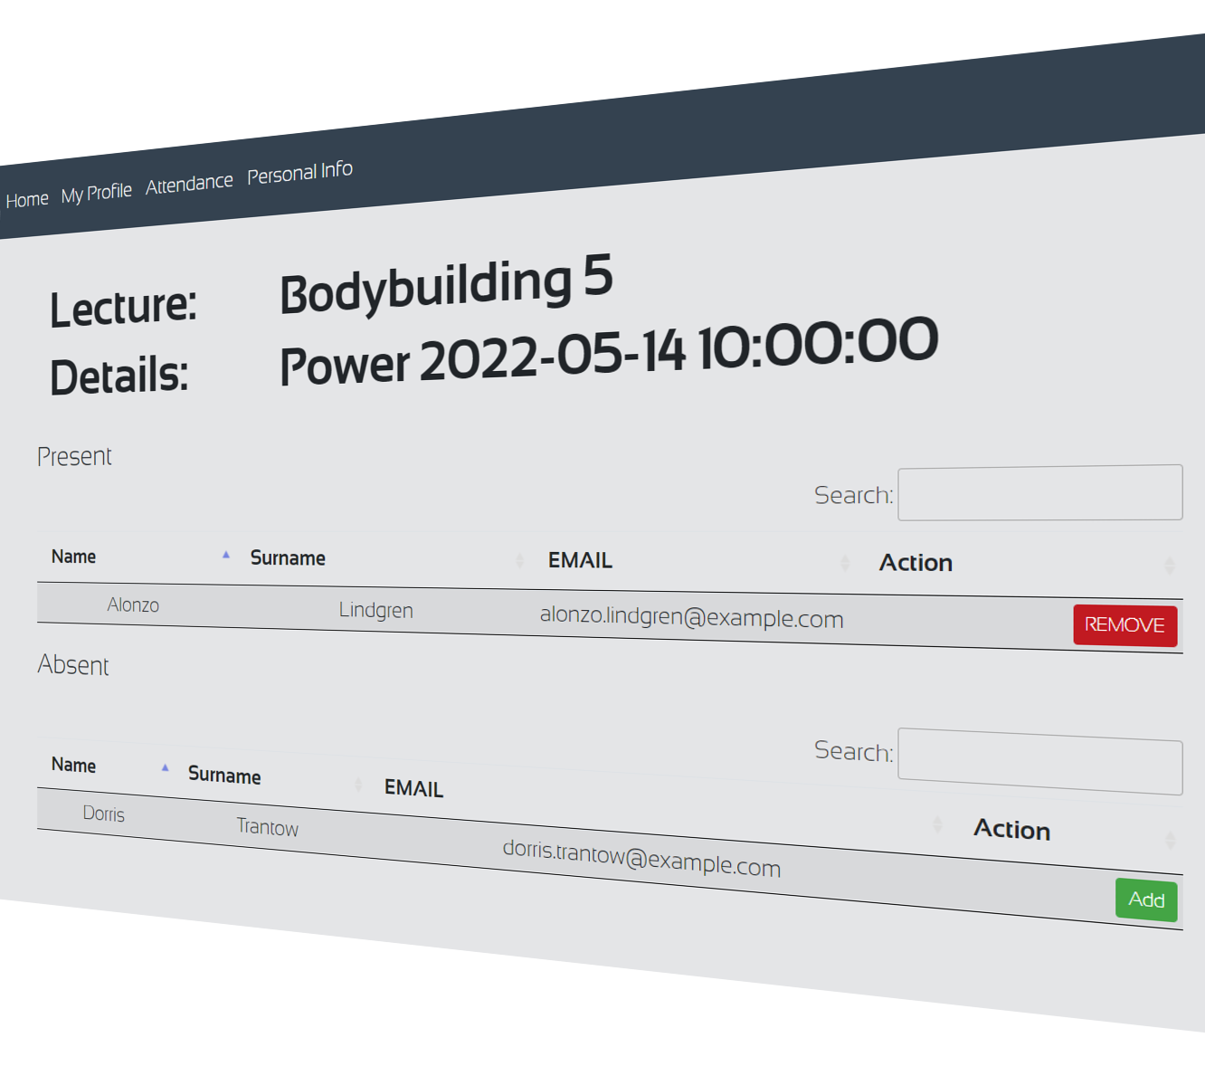
Trainer: manage attendances
Managing attendances is possible when a lecture of a courses taught by the trainer has already started. At this point the trainer can:
Remove attendances of users not present at the lecture
Add attendances of users subscribed to the course but who have not booked their presence
This is done in order to detect and manage presences to prevent COVID issues.

Slide 13
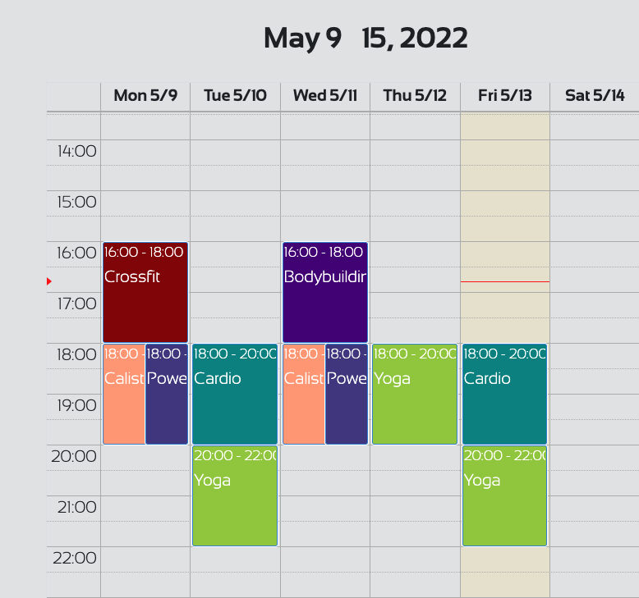
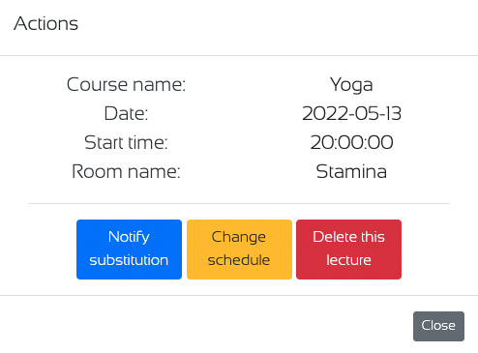
Secretary: managing lectures
When an event of the calendar is clicked a modal will appear.
Inside the modal a user with role secretary can perform the following actions:
Notify substitution of the trainer
Change the schedule for the class
Delete the class

Slide 14
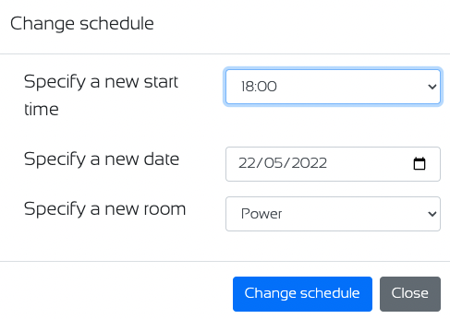
Secretary: notification of changes in the schedule
When the schedule of a class is changed all the users that enrolled for it will be notified by email.
The change of the schedule is implemented with an AJAX.
After the re schedule of the class the calendar will update itself with another AJAX call.

Slide 15
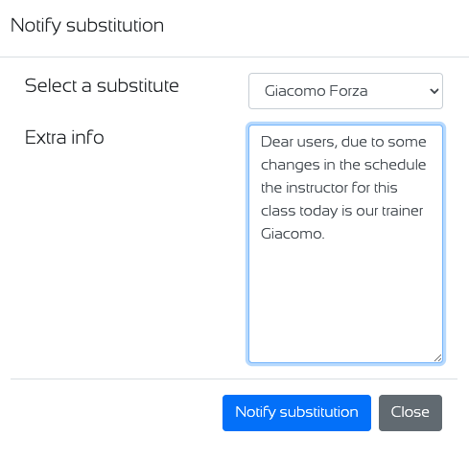
Secretary: notification of trainer’s substitution
The implementation of the substitution procedure is done similarly to the one seen before.
In the text area labelled by extra info some additional details can be given about the motivation of the substitution.
If some details are provided, these are going to be included in the email message sent to all the enrolled users

Slide 16

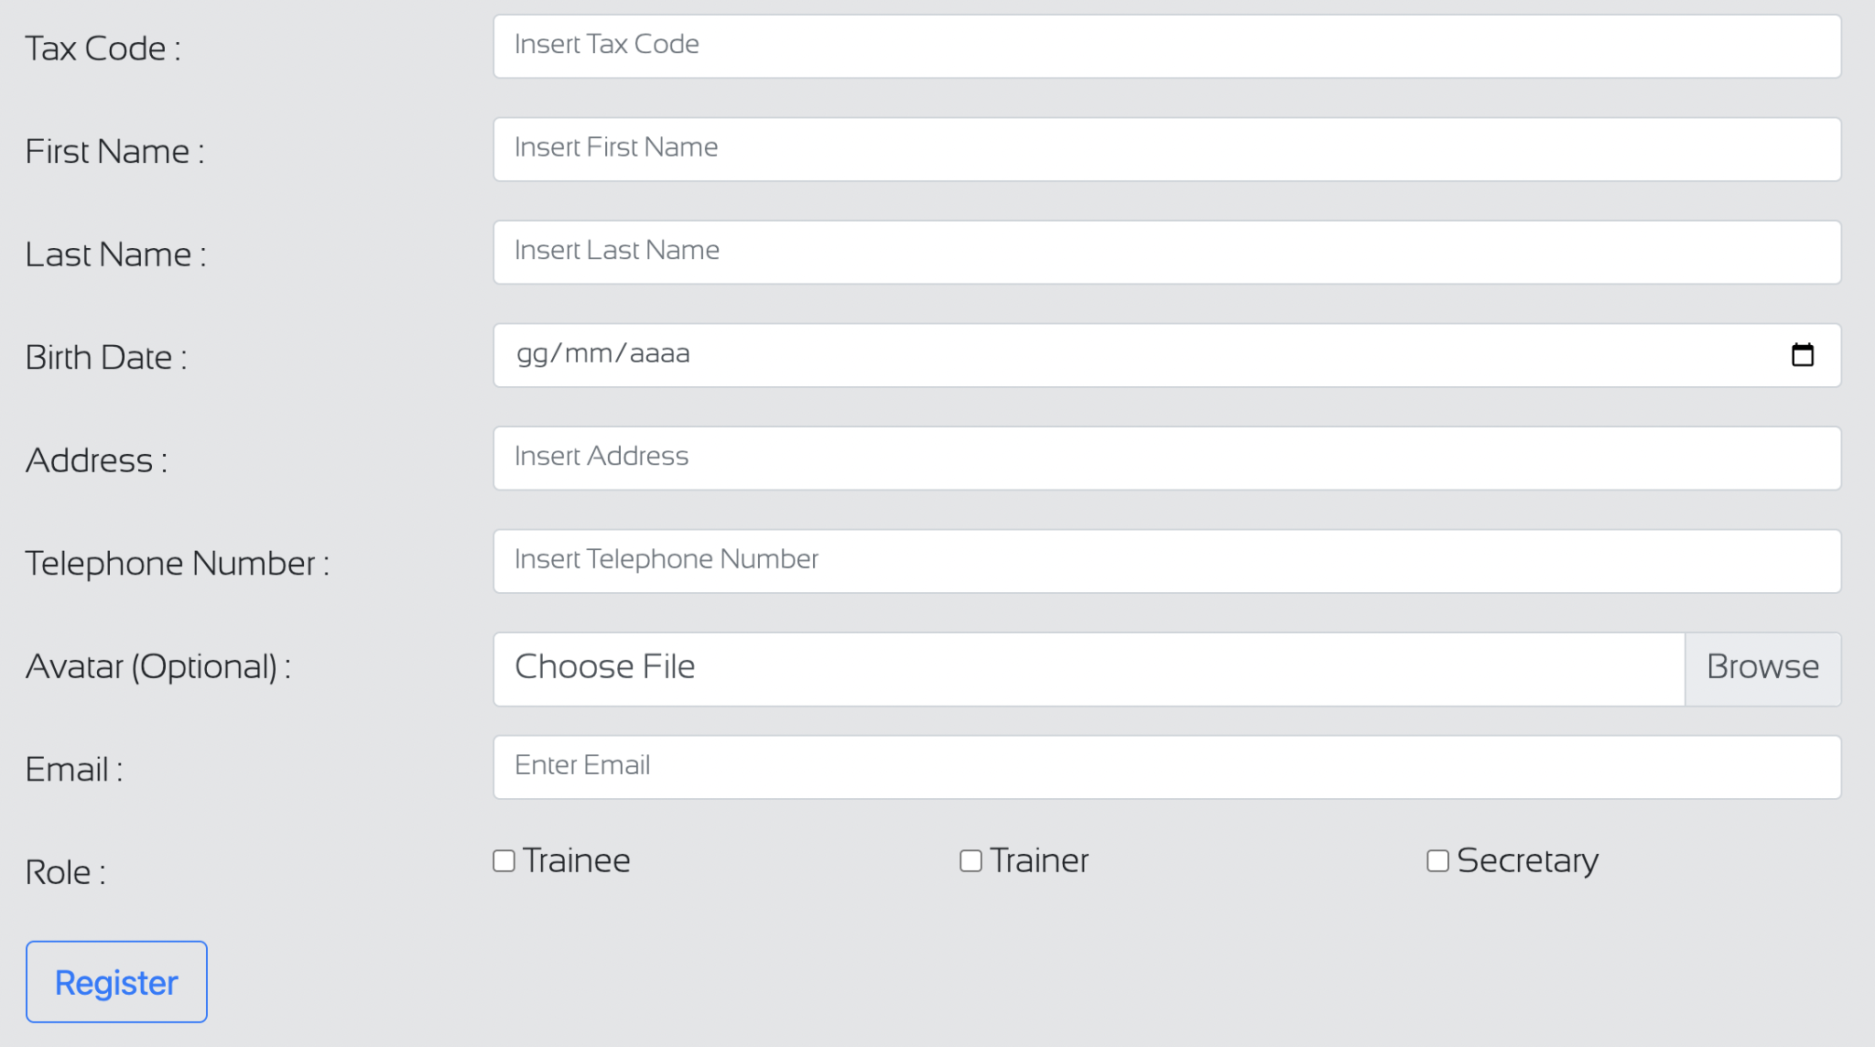
CREATE A NEW ACCOUNT
Trainee users can sign up to GWA on their own, following the Register link in the homepage.
On the contrary, trainer and secretary users must be created by an authenticated and authorized secretary user.
Personal and contact information is needed to create an account. An avatar image can be uploaded, but that’s not mandatory.
A random password is generated for the new account, and the new user is going to receive an email containing a link to set his/her password.

Slide 17

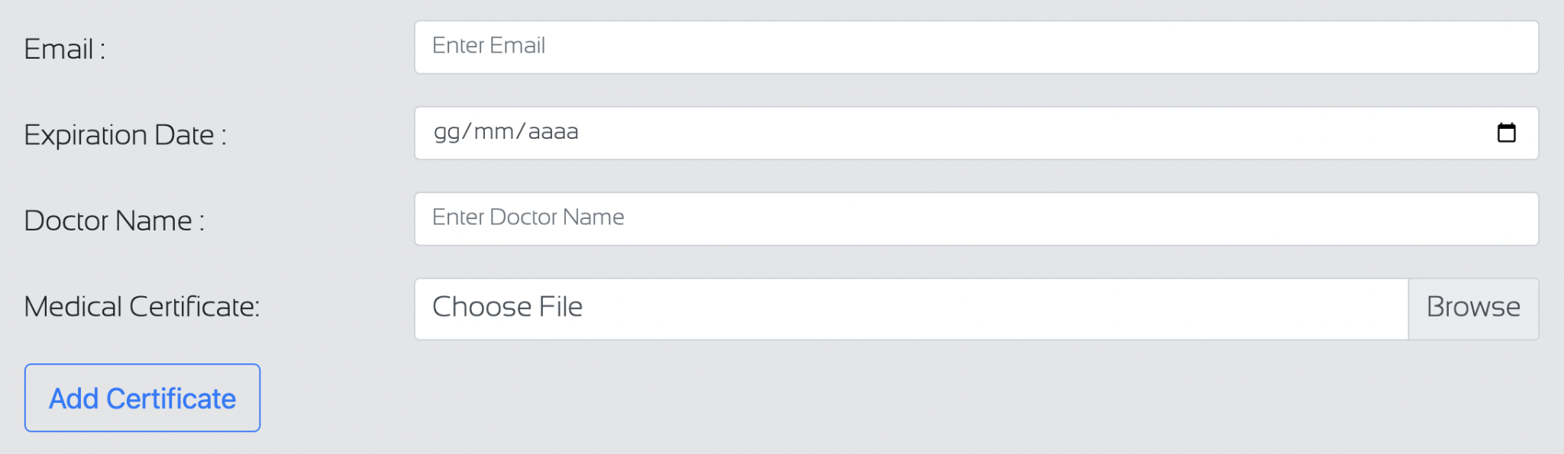
MANAGE MEDICAL CERTIFICATES
First, a secretary user checks the validity of a medical certificate for a user, then scans it, and finally uploads it to GWA. The file provided must be in pdf format and its size must be below 5 MB.

Slide 18

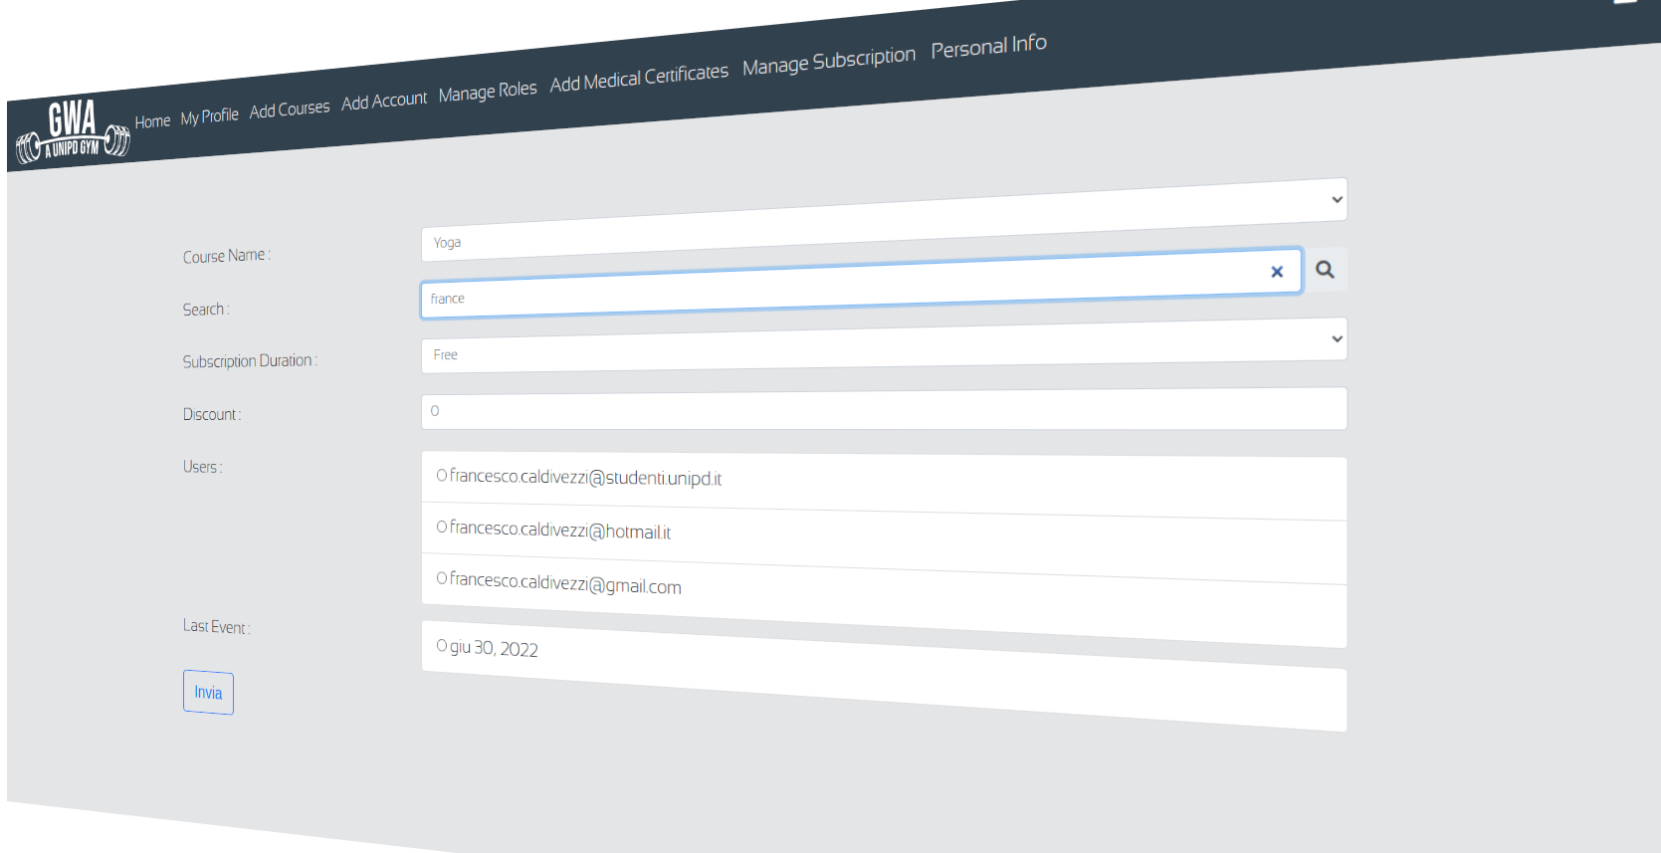
MANAGE SUBSCRIPTIONS
Subscriptions are managed through the user Secretary
We have 5 types of Subscriptions possible, for a given Course Edition : Free/ 7 Days Trial, Monthly, Quarterly, Half-Yearly and Yearly.
A Trainee User can only try a Course once, whatever the edition
Payments are managed on secretariat
To specify a new Subscription a Secretary User needs to :
Choose the email for a certain User
Choose The Correct courseEdition for a User
Some important controls were done on the server side :
Checking if a Trainee User has still a subscription valid etc..

Slide 19
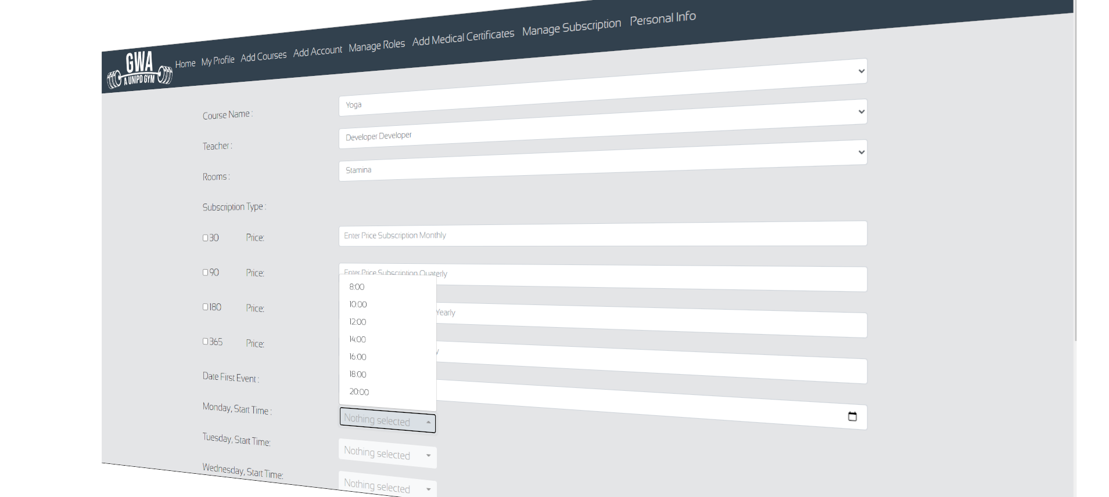

CREATE COURSES
A Secretary User can create a course which means :
Creating a new edition for a given Course
Decide the type of Subscriptions available
with respective costs (free subscription always available)
Adding the lectures for such course by establishing :
In which days of the week the new course is going to be held
When is the first time the course is going to be held
How many weeks it‘s going to last
Who is the teacher of such course among the teachers
Notice that, some important controls were done on the server side in order to :
Avoid Overlapping lectures
Avoid that the same Teacher could be in two rooms at the same time

Slide 20

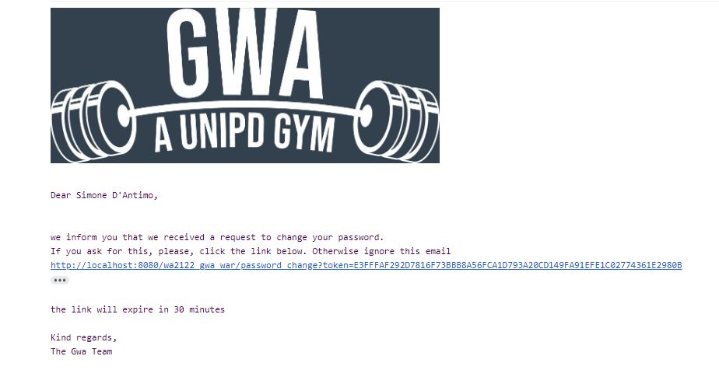
MAIL SYSTEM
In order to communicate with our customer we use an email system.
We sent email for:
Registration process
Reset password process
Medical certificate updated
Successful subscription to course
Changes in Lectures
The body of an email sent by our gym

Slide 21

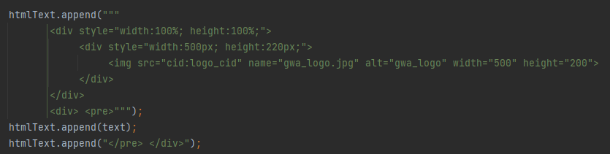
HOW MAIL SYSTEM WORK:
MailTypes.java → Contains static methods that format the plain text of the mail, based on and the input given. Servlets can send mails invoking one of the “MailTypes” static methods.
MailManager.java → Contains a method that , given a subject, a plain text and the destination mail styles the email and then sent it.
Email are formatted using HTML language, the text is concatenated with StringBuilder class

Slide 22
And now we will show our demo !

